Slide 1
SE 211 Software Specification and Design II Principles of Software Architecture

Slide 2
Software Design
Software Architectural Design
The top-level structure and organization of the system is described and the various components are identified.
Software Detailed Design
Each component is sufficiently designed to allow for its coding.

Slide 3
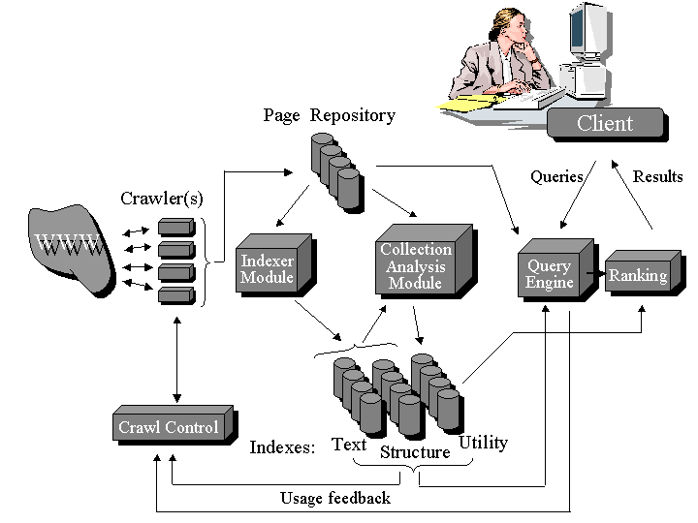
Architectural Design Sample Diagram

Slide 4
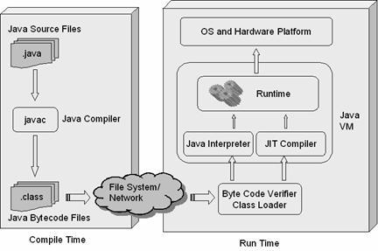
Java Architecture

Slide 5
Software Architecture’s Elements
A software system’s architecture should be a composition and interplay of different elements
Processing
Data, also referred as information or state
Interaction

Slide 6
Components
Elements that encapsulate processing and data in a system’s architecture are referred to as software components
A software component is an architectural entity that:
Encapsulates a subset of the system’s functionality and/or data.
Restricts access to that subset via an explicitly defined interface.
Has explicitly defined dependencies on its required execution context.
Components typically provide application-specific services.

Slide 7
Connectors
A software connector is an architectural building block tasked with effecting and regulating interactions among components.
In complex systems interaction may become more important and challenging than the functionality of the individual components.
In many software systems connectors are usually simple procedure calls or shared data accesses.
Much more sophisticated and complex connectors are possible!
Connectors typically provide application-independent interaction facilities.

Slide 8
Examples of Connectors
Procedure call connectors
Shared memory connectors
Message passing connectors
Streaming connectors

Slide 9
Architecture Defines Structure
Decomposition of system in to components/modules/subsystems
Architecture defines:
Component responsibilities
Precisely what a component will do when you ask it
Component interfaces
What a component can do
Component communications and dependencies
How components communicate

Slide 10
Architecture Specifies Component Communication
Communication involves:
Data passing mechanisms, e.g.:
Remote method invocation
Asynchronous message
Control flow
Sequential
Concurrent/parallel

Slide 11
Who Impacts the Architecture?
Architects must:
Work with various application stakeholders: Architects play a pivotal liaison role by making sure all the application’s stakeholder needs are understood and incorporated into the design.
Work with the requirements team: The architect plays an important role in requirements gathering by understanding the overall systems needs and ensuring that the appropriate quality attributes are explicit and understood.
Work with the project management: Planning, estimates, budgets, schedules.
Lead the technical design team: Defining the application architecture is a design activity.
Ensure faithful implementation.

Slide 12
Where Does Architecture Fit In?
Business Case
Planning and Architecture Phase
Requirements
Carries through the life of the project
Architecture
High Level Design
Detailed Design

Slide 13
Requirements That Shape Architecture
Quality Attributes
performance,
security,
modifiability,
…
Functional Requirements
what the system must do
Software Architecture
Constraints decisions made externally (e.g., which OS, which devices, etc.)

Slide 14
Example
A typical architecture requirement :
“Communications between components must be guaranteed to succeed with no message loss”

Slide 15
Constraints
Constraint | Architecture Requirement
Business | The technology must run as a plug-in for MS BizTalk, as we want to sell this to Microsoft.
Development | The system must be written in Java so that we can use existing development staff.
Schedule | The first version of this product must be delivered within six months.
Constraints impose restrictions on the architecture and are (almost always) non-negotiable.
They limit the range of design choices an architect can make.

Slide 16
Quality Attributes
QAs are part of an application’s Non-Functional Requirements
“how” the system achieves its functional requirements
There are many QAs
Architect must decide which are important for a given application
Understand implications for application
Understand competing requirements and trade-offs

Slide 17
Quality Attributes (cont’d)
Often know as –ilities
Reliability
Availability
Portability
Scalability
Performance (!)

Slide 18
Quality Attribute Requirements
QA | Architecture Requirement
Performance | Application performance must provide sub-four second response times for 90% of requests.
Scalability | The application must be able to handle a peak load of 500 concurrent users during the enrollment period.
Modifiability | The architecture must support a phased migration from the current Forth Generation Language (4GL) version to a .NET systems technology solution.
Availability | The system must run 24x7x365, with overall availability of 0.99.
Resource Management | The server component must run on a low end office-based server with 512MB memory.
Usability | The user interface component must run in an Internet browser.
Reliability | No message loss is allowed, and all message delivery outcomes must be known with 30 seconds.
Security | All communications must be authenticated and encrypted using certificates.

Slide 19
Architecture Views
A software architecture represents a complex design artifact
Many possible ‘views’ of the architecture
Cf. with buildings – floor plan, external, electrical, plumbing, air-conditioning

Slide 20
Architecture Views (cont’d)
Logical view
Process view
Development view
Physical view

Slide 21
Architecture Views (cont’d)
Marketecture
Informal depiction of system’s structure and interactions.
Portray the design philosophies embodied in the architecture.
Every system should have a marketecture:
Easy to understand.
Helps discussion during design, build, review, sales (!) activities.

Slide 22
Designing the Logical Architecture
The logical view is used to decompose systems into logical components that represent the structural integrity that supports functional and non-functional requirements.
The logical view can be modeled using:
Component diagrams
Class diagrams
Box-and-line diagrams

Slide 23
Logical Architecture

Slide 24
Designing the Process Architecture
The process view is used to represent the dynamic or behavioral aspects of software systems, where the main units of analysis are processes and threads.
With this view, the system is decomposed into processes and threads to address design issues that deal with the dynamic flow of control between architectural elements.
The process view can be modeled with UML using:
Sequence diagrams
Communication diagrams

Slide 25
Process Architecture
Based on the received message, the SiteManager stops data collection using the video camera.
Threads in the system using asynchronous communication
<<thread>>
m3: VideoManager
4. stopCollection ()
<<thread>>
<<thread>>
1. receiveMsg(msg)
comm: CommMgr
m2: SensorMgr
m1: SiteManager
4. startCollection ()
2. sendMsg(ACK)
3. update(msg)
uiManager : Observer
Based on the received message, the SiteManager initiates data collection using the sensors.
The SiteManager uses the CommMgr to receive a message. After receipt, the SiteManager sends an immediate ACK response, to indicate that the message is received. After that, it updates the user interface to display the receipt of the message.

Slide 26
Designing the Development Architecture
The development view of software systems represents the software development configuration aspects of the software system.
The main units of decomposition are actual physical files and directories.
This view can be used to analyze the system from the perspective of how logical components map to physical files and directories.

Slide 27
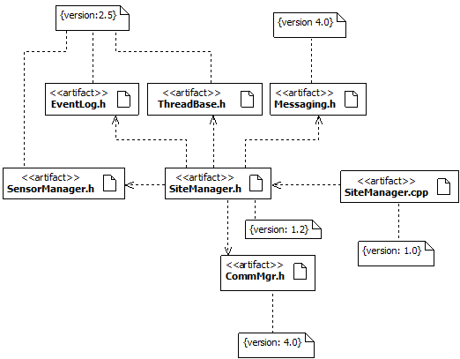
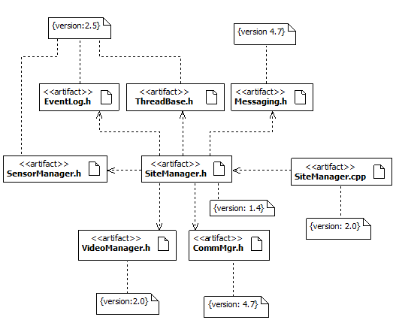
Development Architecture
Notice how versions change with the addition of new functionality!
Version 1.0
Version 2.0
Version 1 of the SiteManager
Version 2 of the SiteManager
Version 1.0 is used by a specific customer that does not require video capture capabilities.
Version 2.0 is used by a specific customer that requires video capture capabilities.

Slide 28
Designing the Physical Architecture
The physical view represents the deployment aspects of software systems.
The main elements of analysis are nodes, connections between nodes, and the mapping of artifacts to these nodes.
This view can be used to model the run-time dependencies of the system.
The physical view can be modeled in UML using:
Deployment diagrams

Slide 29
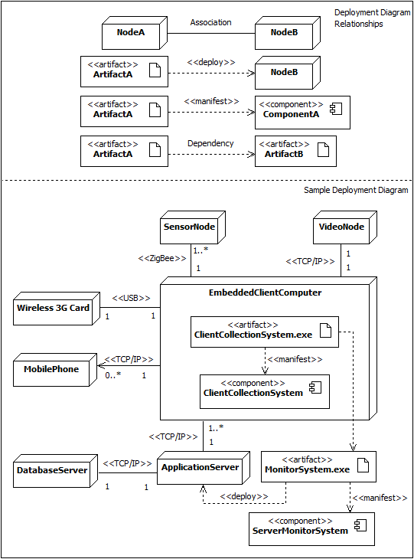
Designing the Physical Architecture

Slide 31
The Power of Architecture
What is the World Wide Web?
How is it built?
How do you explain the Web to a child?
How do you designing Web-based e-commerce software?

Slide 32
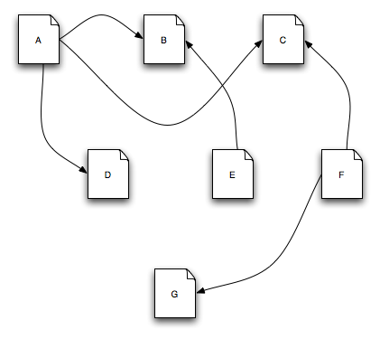
The Architecture of the WWW
This is the Web – a collection of interrelated pieces of information.

Slide 33
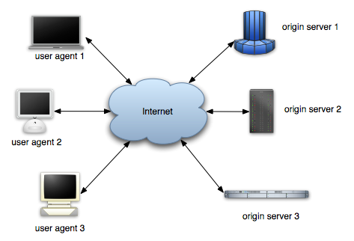
The Architecture of the WWW (cont’d)
So is this – a collection of computers interconnected through the internet.

Slide 34
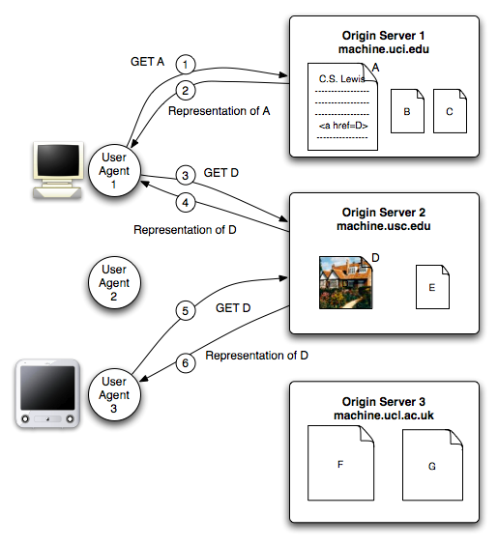
The Architecture of the WWW (cont’d)
And this – the user agents, the origin servers, and the location of the documents.

Slide 35
WWW in a (Big) Nutshell
The Web is a collection of resources, each of which has a unique name known as a uniform resource locator, or “URL”.
Each resource denotes, informally, some information.
URLs can be used to determine the identity of a machine on the Internet, known as an origin server, where the value of the resource may be ascertained.
Communication is initiated by clients, known as user agents, who make requests of servers.
Web browsers are common instances of user agents.

Slide 36
WWW in a (Big) Nutshell (cont’d)
All communication between user agents and origin servers must be performed by a simple, generic protocol (HTTP).
All communication between user agents and origin servers must be fully self-contained. (So-called “stateless interactions”)

